Slide 1
Building a High-Assurance Unpiloted Air Vehicle
Lee Pike (speaker), Pat Hickey, James Bielman, Trevor Elliott, John Launchbury, Erlend Hamberg, Thomas DuBuisson
MEMOCODE | Oct 2013
Notes:
<number>
[Introduction]
<click> Lots of people have contributed

Slide 2
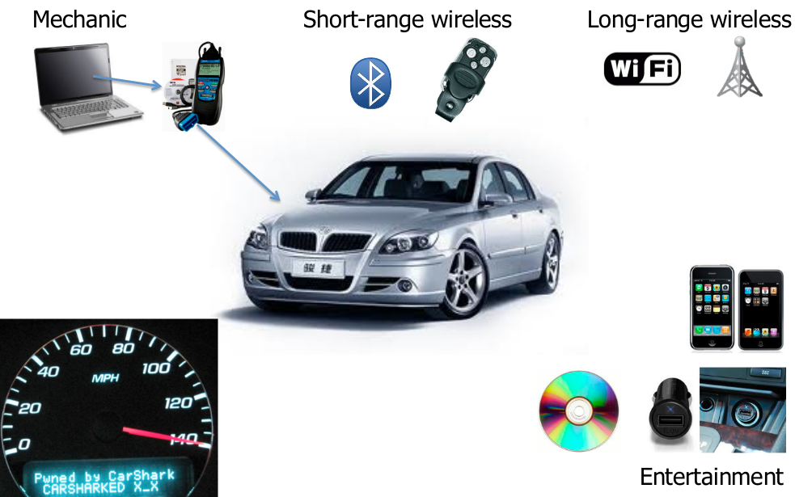
The Problem
src: Kathleen Fisher, http://www.cyber.umd.edu/events/symposium
Notes:
What's new about embedded security?
networking: full connection for safety
less memory, less isolation, slower networking:
sweet-spot between computation and crypto
heterogenous systems, broken SW abstractions

Slide 3

The Challenge
High-Assurance Cyber-Military Systems (HACMS)
PM: Dr. Kathleen Fisher
http://www.darpa.mil/Our_Work/I2O/Programs/High-Assurance_Cyber_Military_Systems_(HACMS).aspx

Slide 4
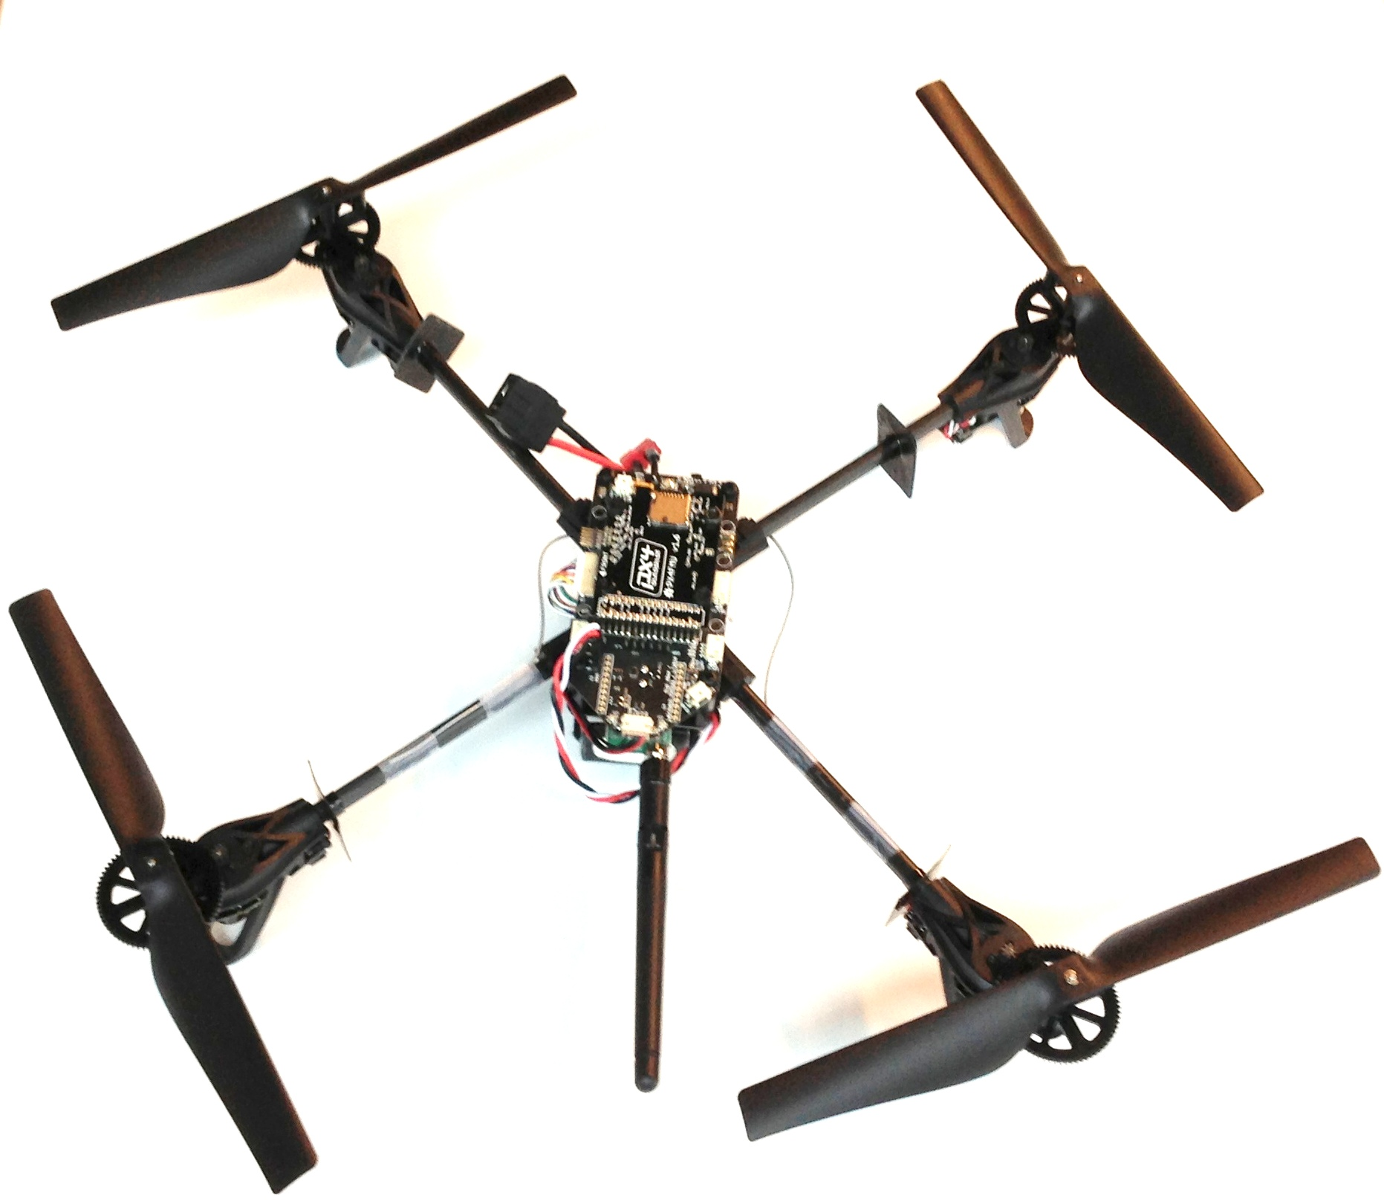
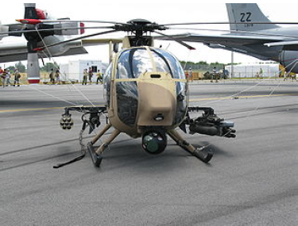
The “Air Team”
Boeing: military vehicle
Galois, Inc.: autopilot synthesis
NICTA: networking/operating systems
Rockwell Collins/Univ. Minn.: integration and architecture
DRAPER/AIS/U. Oxford (Red Team): vulnerability analysis

Slide 5

SMACCMPilot
Secure
Mathematically
Assured
Composition of
Control
Models

Slide 6
This Talk
How we built have nearly built
Ivory: a memory-safe language/compiler
Tower: an architectural coordination language
SMACCMPilot: a high(er)-assurance autopilot
in 2-3 engineer-years (~1 calendar year).

Slide 7
How We Did It
Collaborate with a vibrant open-source system/community
Build embedded domain-specific languages (EDSLs) and type-safe macros
Synthesize the architecture

Slide 8
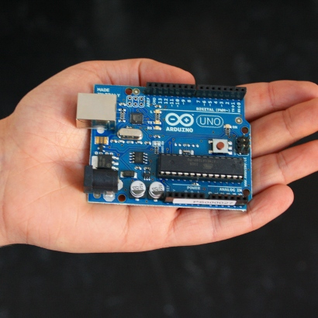
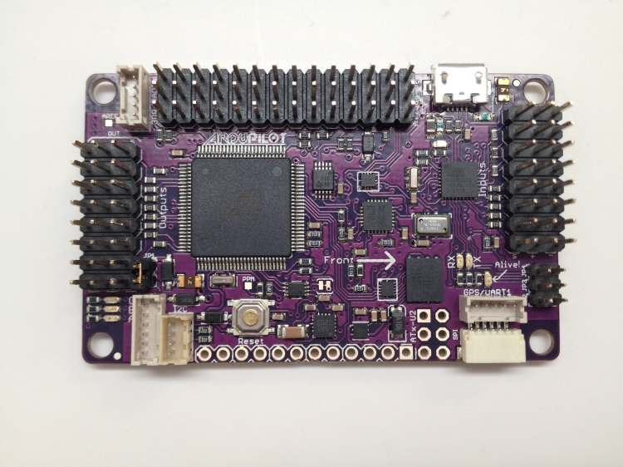
In the Beginning...
There was Arduino
Simple 8-bit AVR
For DIY beginners in embedded systems
ArduPilot Mega Hardware
AVR Processor: 8 bit, 16MHz,
8k RAM, 256k Flash

Slide 9
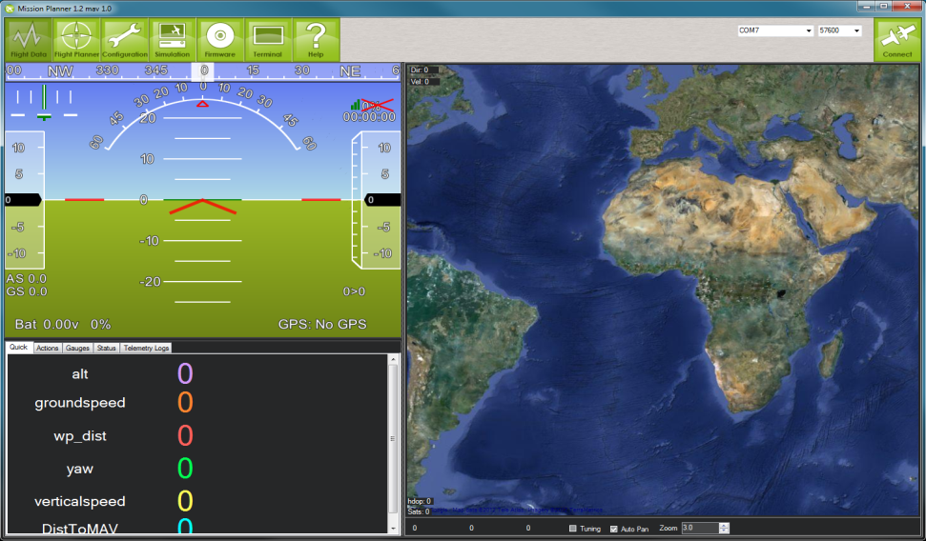
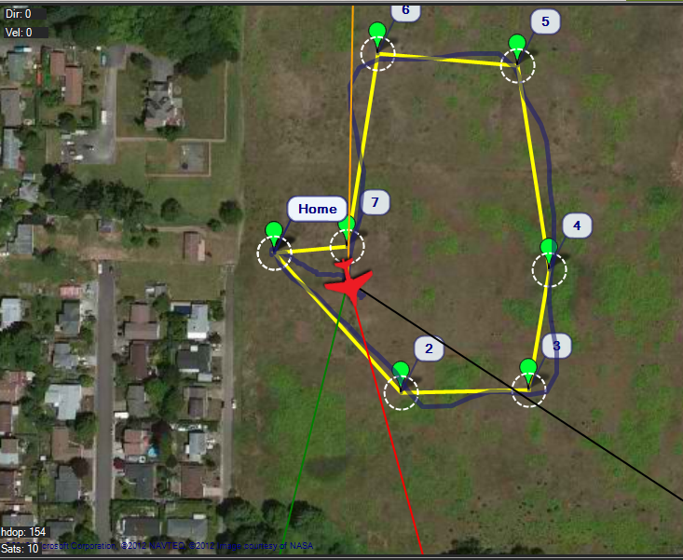

ArduPilot
ArduPilot
Arduino-based
Open-source hardware and software
25 volunteer developers worldwide
1000s of users
Starting to see commercial use
DIYDrones.com
30,000 users, 99% amateurs and hobbyists
Home of the ArduPilot project
Emphasis on beginner friendly

Slide 10
ArduPilot Robustness
Monolithic design
Platform-specific C/C++
Hobbyist use-cases
No communication security, fault-tolerance
But being adopted in security-critical environments
No regimented testing/verification story
Military systems often not much better

Slide 11
The Hardware Abstraction Layer (HAL)
Gave back to the open-source community.
The foundation for ArduPilot now.

Slide 12
Designing a Language for Safety and Security
Design goal: give the programmer a few centimeters less rope than required to hang herself
Help ensure
Memory safety
Timing safety (i.e., easier WCET analysis)
Functional correctness
While being flexible:
bit-data manipulation
memory-area manipulation
“escaping” to/interrop with C
readable generated code

Slide 13
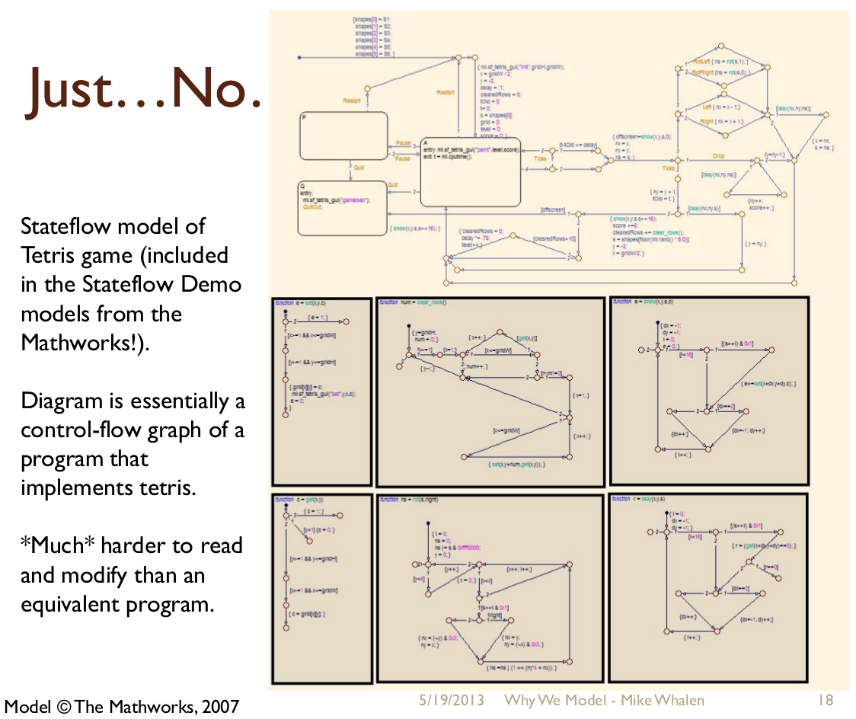

Slide 14
Haskell
Strong, static, polymorphic type checking and inference
Pure, higher-order language—no side effects
Functional programing for modularity: program composition is function composition
Why Functional Programming Matters by John Hughes (1990)

Slide 15
What if...
Can we have the high-level abstractions and type-safety of functional programming in embedded systems programming?
Approaches:
Design a new FP-inspired language/compiler from scratch? No:
Would take too long
No library support
Take the Haskell compiler and pair it down? No:
The runtime system is 50KLOCs of C/C--
And there's little control over memory usage (it's lazy) and it's a hog--”hello world” takes over 1MB

Slide 16
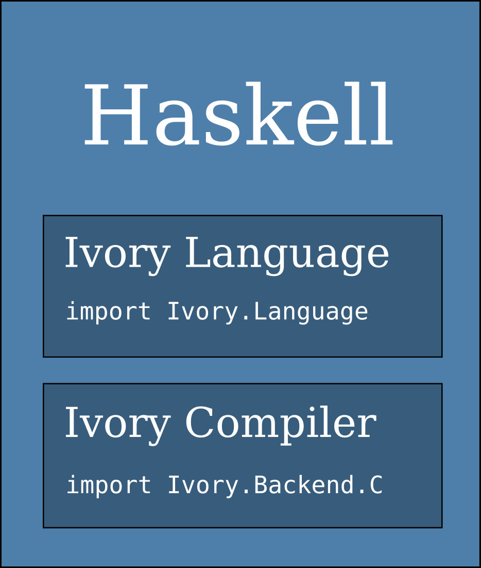
EDSL
Building a programming language is hard!
Get your programming language features for free:
Syntax & Parser
Type Checker
Macro language is type-safe and Turing-complete
“Just” a powerful Haskell library
Ivory language: 2.5KLOCs
Ivory compiler: 1.2KLOCs

Slide 17
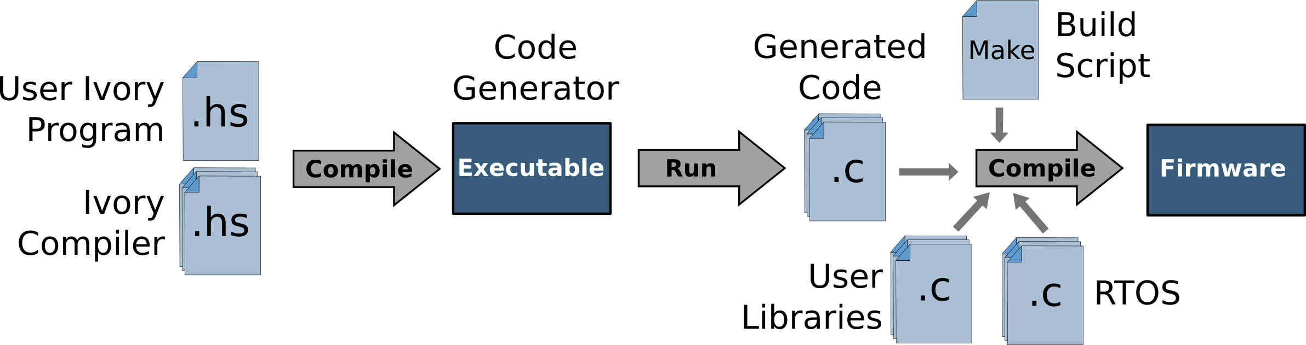
Compiling and Running Ivory

Slide 18
Who's Used EDSLs?
Eaton: garbage truck controllers
Boeing: component configuration
Ericsson: DSP
Xilinx: FPGA synthesis
Soostone: high-speed trading
...

Slide 19
Ivory Example
Loop over an array adding x to each element:
Type automatically
inferred
arrayExample :: Def('[ Ref s (Array 4 (Stored Uint8))
, Uint8
] :-> ())
arrayExample = proc "arrayExample"
$ \arr x -> body
$ arrayMap
$ \ix -> do
v <- deref (arr ! ix)
store (arr ! ix) (v + x)
Map over the elements of the array
Guaranteed dereference arr at ix
Store v+x at index ix

Slide 20
Haskell as Type-Safe Macro Language
arrayExample :: Def('[ Ref s (Array 4 (Stored Uint8))
, Uint8] :-> ()
)
arrayExample = proc "arrayExample"
$ \arr x -> body
$ arrayMap
$ \ix -> do
v <- deref (arr ! ix)
store (arr ! ix) (v + x)
(arrAdd arr x)
Type-safe Haskell function call:
No overhead in generated code
arrAdd :: (Num a, SingI len, IvoryStore a)
=> Ref s (Array len (Stored a))
-> a
-> Ix len
-> Ivory eff ()
arrAdd arr x ix = do
v <- deref (arr ! ix)
store (arr ! ix) (v + x)
And arbitrary data-types
Can be used for arbitrary-length arrays

Slide 21
Macros, Example 2
data Cond eff = Cond IBool (Ivory eff ())
(==>) = Cond
cond [] = return ()
cond (Cond b f : cs) = ifte_ b f (cond cs)
ifte (x >? 100)
(store result 10)
(ifte (x >? 50)
(store result 5)
(ifte (x >? 0)
(store result 1)
(store result 0)))
cond
[ x >? 100 ==> store result 10
, x >? 50 ==> store result 5
, x >? 0 ==> store result 1
, true ==> store result 0
]

Slide 22
Ivory Memory-Safety
No null pointer dereferences
No out-of-bounds array-indexing
No unsafe implicit casting
No unexpected type coercions—even satisfying the C standard!
Distilled ArduPilot bug discovered by Galois:
...
uint8_t a = 10;
uint8_t b = 250;
printf("Answer: %i, %i", a-b > 0, (uint8_t)(a-b) > 0);
...
Answer: 0, 1
Assuming int > uint8_t

Slide 23
Ivory: What We Removed
No heap allocation (only stack)
Unbounded looping combinators
Except for a single forever combinator
void type
Machine-dependent sizes (modulo float, double)
Side-effecting expressions
Pointer arithmetic

Slide 24
Ivory: What We Added
Effect types
Allocation effects: “This function can't (stack) allocate memory”
Escape effects: “No break is allowed in this loop”
Return effects: “This macro cannot contain a return statement”
References (guaranteed non-null pointers)
Array map/fold combinators
Automatic assertions
arithmetic underflow/overflow
div-by-zero
user-specified assertions

Slide 25
Ivory: TBD
Sum types (unions)
Fat pointers/strings
Function pointers
A better module system
Interpreters for embedded software

Slide 26
Tower

Slide 27
Tower: a Glue Code Macro Language
Goal: address the “glue code” problem: task initialization and communication.
Specifies how a tasks are scheduled and communicate
Pub/sub model
Provides both time-triggered and event-triggered behaviors
Channels (queues) and data-ports (shared data) communication
Able to specify both interrupt handlers and user tasks
Tower is “just” Ivory macros so has all the type-safety guarantees of Ivory—and no new code generator!
We generate AADL

Slide 28
Tower example
Signal task
LED hardware
controller task
On/off?

Slide 29
Signal Task
blink :: SingI n
=> ChannelSource n (Stored IBool)
-> Task ()
blink chan = do
tx <- withChannelEmitter chan "bTx"
onPeriod period
(body tx period)
where period = 100 :: Integer
Tower
Specify the output channel
Specify when computation takes place
What the task actually does
body ::(SingI Nat n, GetAlloc eff ~ Scope cs)
=> ChannelEmitter n (Stored IBool)
-> Integer
-> a
-> Ivory eff ()
body tx period currTime = emitV_ tx (even currTime)
where
even = currTime .% (2*p) <? p
p = fromIntegral period
Ivory
Send 0,1,0,1 ...

Slide 30
Tower Code Generation
void tower_task_loop_blink_1()
{
uint32_t n_local0 = 0U;
uint32_t* n_ref1 = &n_local0;
uint32_t n_r2 = ivory_freertos_task_getmilliscount();
*n_ref1 = n_r2;
{
int forever_loop __attribute__((unused));
for (forever_loop = 0; FOREVER; FOREVER_INC) {
uint32_t n_r3 = ivory_freertos_task_getmilliscount();
uint32_t n_deref4 = *n_ref1;
ASSERTS(250U >= n_r3 - n_deref4);
ASSERTS(n_r3 >= n_deref4);
uint32_t n_let5 = 250U - (n_r3 - n_deref4);
guardBlock_blink_1(n_let5);
uint32_t n_r6 = ivory_freertos_task_getmilliscount();
. . .

Slide 31
SMACCMPilot

Slide 32
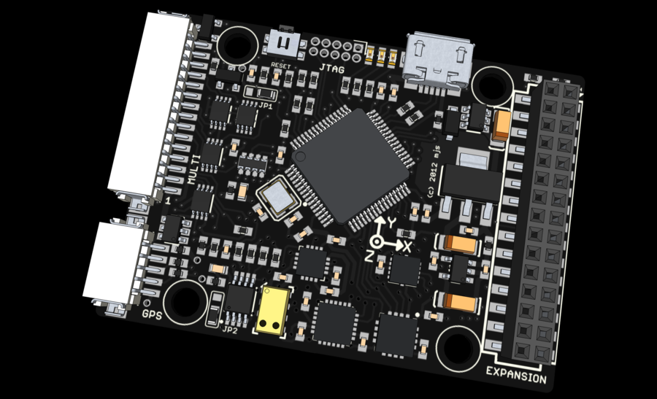
The Hardware
ArduPilot Mega Hardware (Legacy)
AVR Processor: 8 bit, 16MHz,
8k RAM, 256k Flash
PX4 Hardware (SMACCMPilot)
ARM Cortex M4 Processor: 32 bit,
168Mhz, 192k RAM, 1024k Flash
https://pixhawk.ethz.ch/px4/en/start

Slide 33
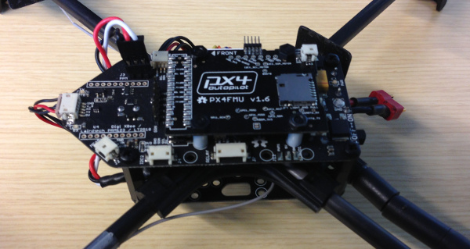
SMACCMPilot Architecture
Timer
Driver
Input
Decoder
RC Receiver
Stabilization
UART
Driver
Decrypt/
Auth.
Packet
Decode
Modem
GCS
Comms
Packet
Encode
Encrypt/
Sign
UART
Driver
Modem
Gyro + Accel
I2C, SPI
Drivers
Sensor
Fusion
Auto
Flight Modes
Motor
Mixing
UART
Driver
Compass
Motors
Barometer
UART
Driver
GPS
Approx. 5x code generation

Slide 34
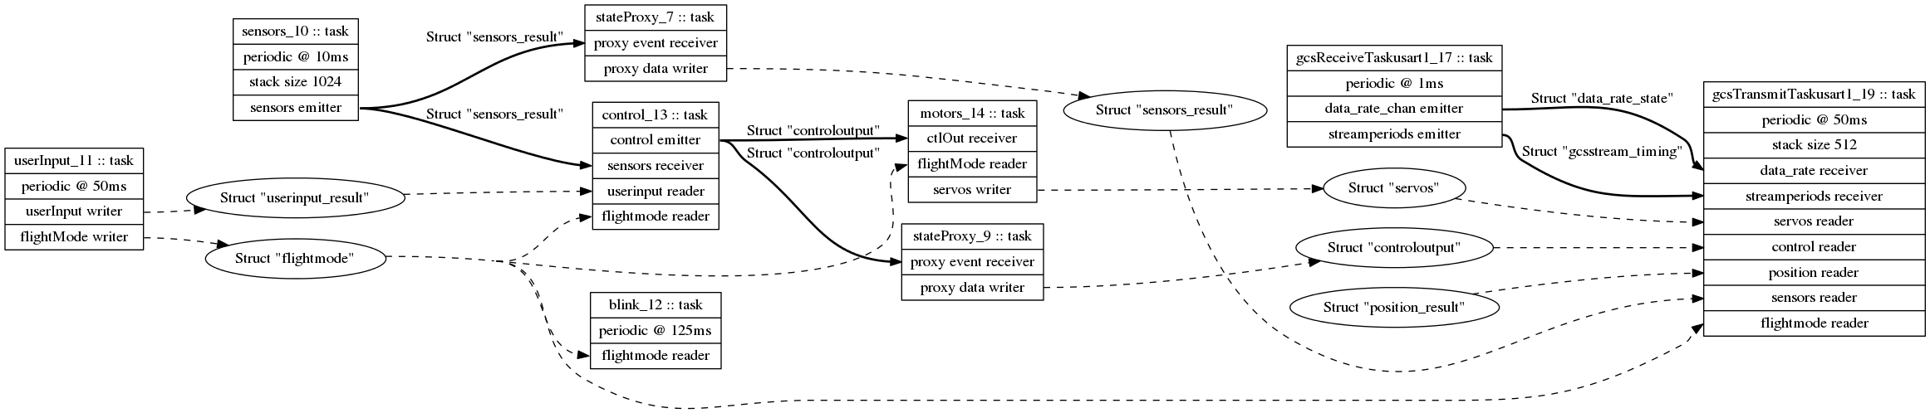
SMACCMPilot Dataflow

Slide 35
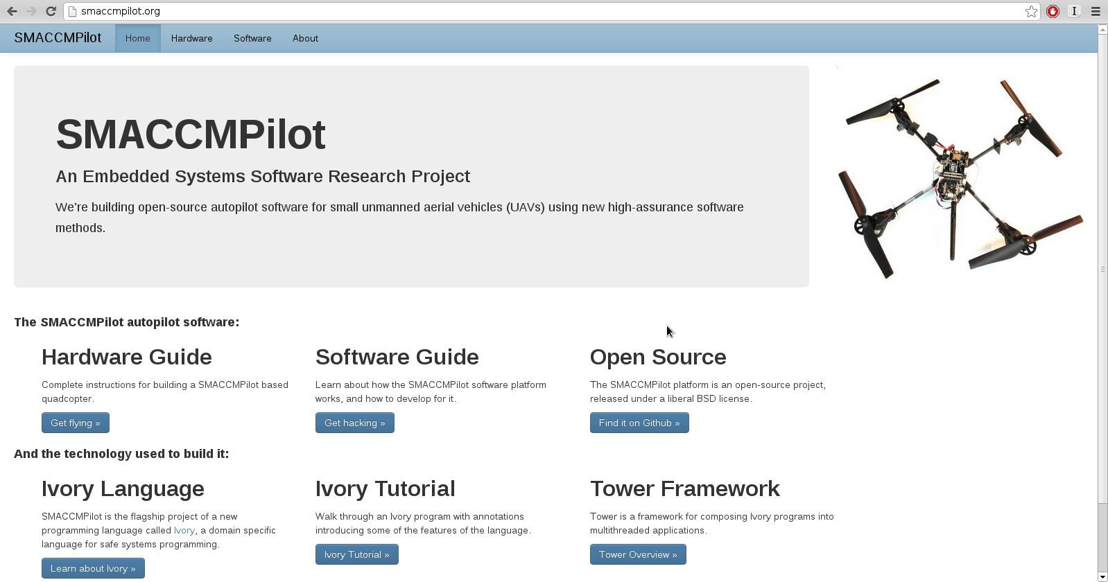
smaccmpilot.org

Slide 36
Lessons Learned/Open Problems
Memory safety isn't a pancea
We still test/debug/verify
Traceability from DSLs to object code is necessary
But the kinds of bugs is restricted: seg-faults, memory leaks don't happen
EDSL shortcomings:
Reusing a general-purpose type-checker
Requires host-language knowledge
Abstractions/macros can affect performance
Compilation cycle
Interpreters for embedded systems are hard
Have not proved architectural properties or verified controllers

Slide 37

Questions

